Slide 1
Modeling and Simulation in Python DATA 604 - Final Project
Beshkia Kvarnstrom

Slide 2
Instructions
Using SimPy, write a process simulation that includes waiting time (discrete event simulation).
You may use any topic of interest to you. Write the simulation and all of the following in Jupyter.
Each element is worth 5 points and will be graded using the rubric shown here.
State the problem and its significance.
Provide a flow-chart model.
Simulate the process for the appropriate number of iterations (justify)
Justify the validity of the model and discuss how you verified it.
State your conclusions/ findings from the model.
Generate appropriate graphs (more than one) to illustrate the results and provide a PowerPoint presentation to share with your colleagues.

Slide 3
Data Source
The dataset contains historical call center data, including timestamps for call arrivals, call durations, and the wait times of each call. This dataset will serve as the foundation for developing and validating the discrete event simulation model.
The dataset was acquired from: Call Center Queue Simulation

Slide 4
Problem Statement
The call center of a telecommunications company faces challenges in efficiently managing its incoming customer calls, resulting in long waiting times and reduced customer satisfaction. To improve the call center's performance, there is a need to analyze and optimize the call handling process using a discrete event simulation approach. The Call Center Queue Simulation dataset will be used to simulate the waiting time experienced by customers in an interpreter service, based on the dataset provided. The significance of this problem is to analyze and optimize the service's efficiency, understand the factors affecting waiting times, and make informed decisions to improve customer satisfaction.
Key Objectives:
Develop a discrete event simulation model of the call center queueing process to replicate real-world dynamics accurately. Analyze the historical data to understand call arrival patterns, call durations, and fluctuations in the number of available agents throughout the day.

Slide 5
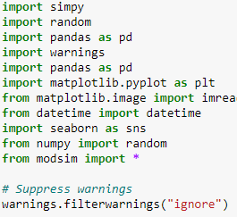
Import required libraries

Slide 6
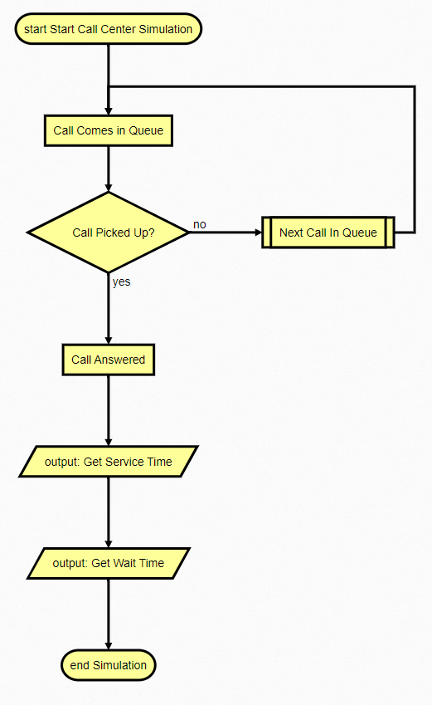
Call Center Process Flow Chart

Slide 7
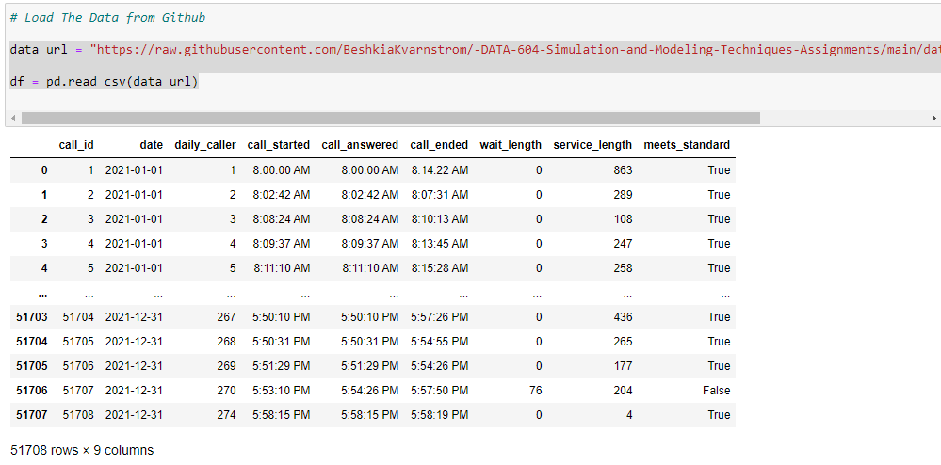
The Data

Slide 8
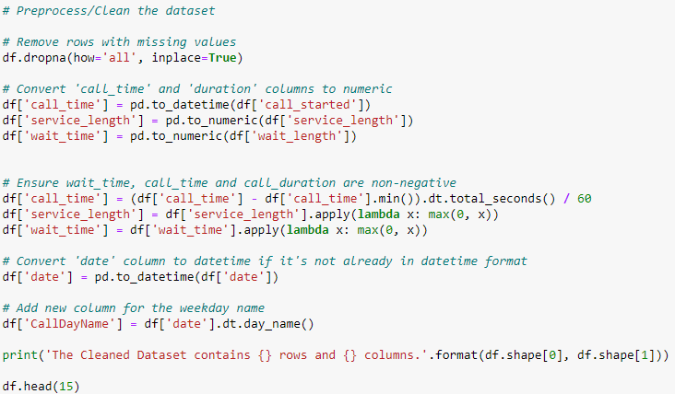

Slide 9
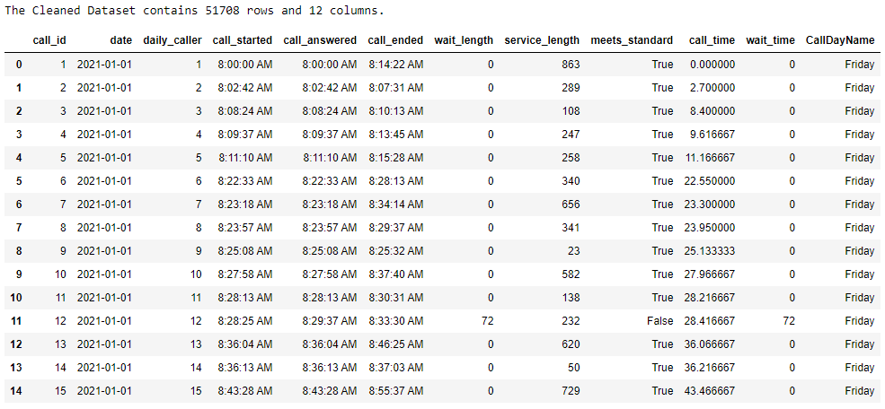

Slide 10
DATA ANALYSIS

Slide 11
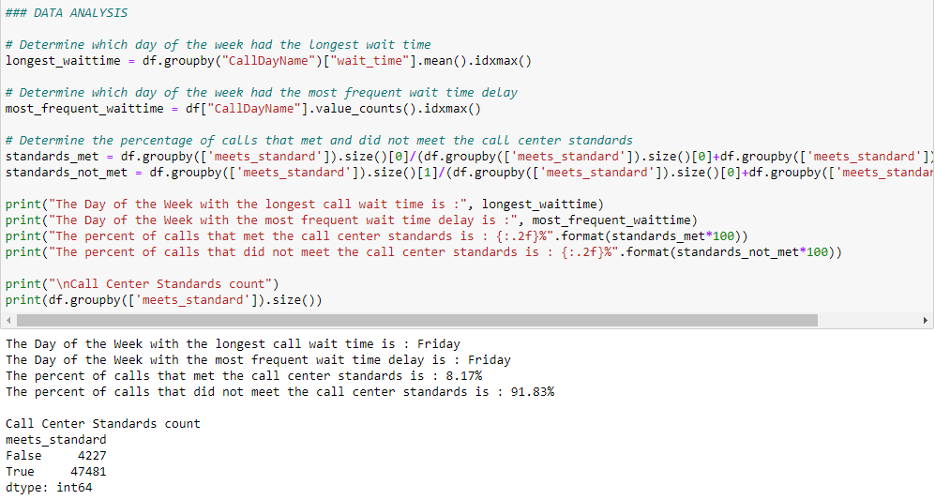

Slide 12
DATA VISUALIZATION

Slide 13
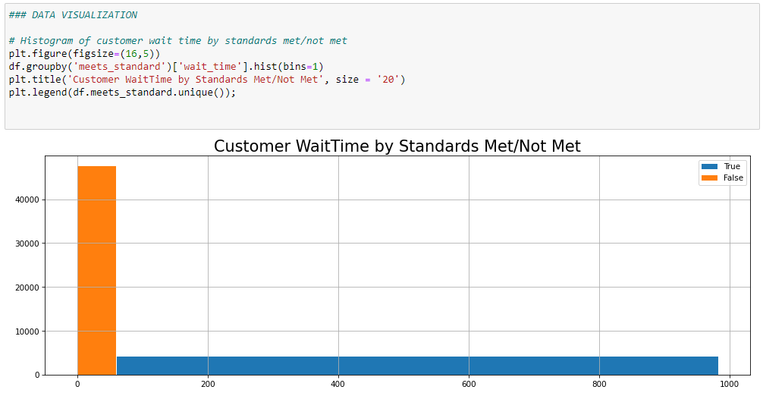

Slide 14
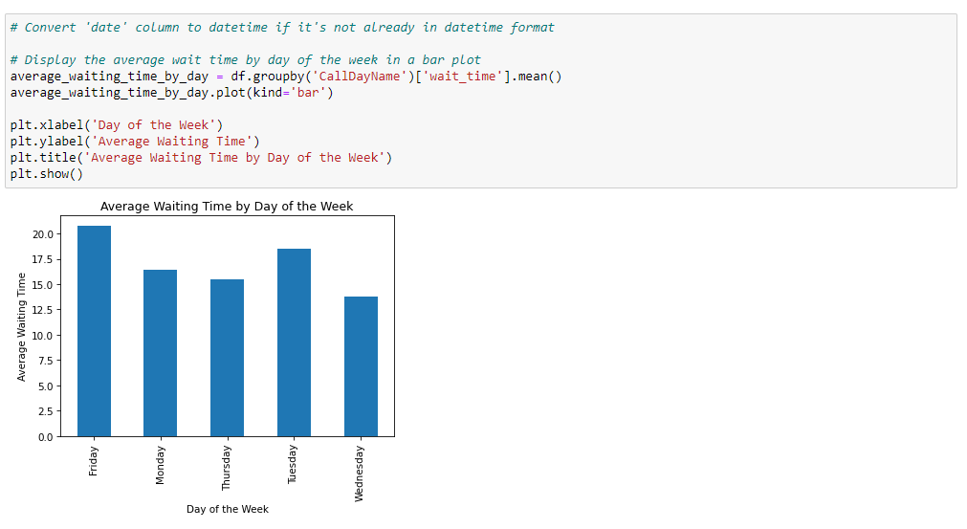

Slide 15
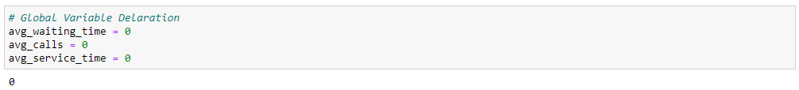
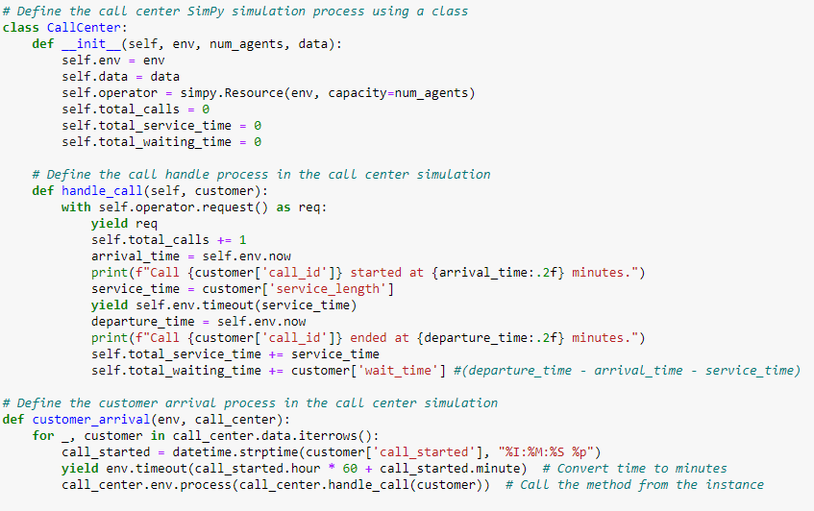

Slide 16
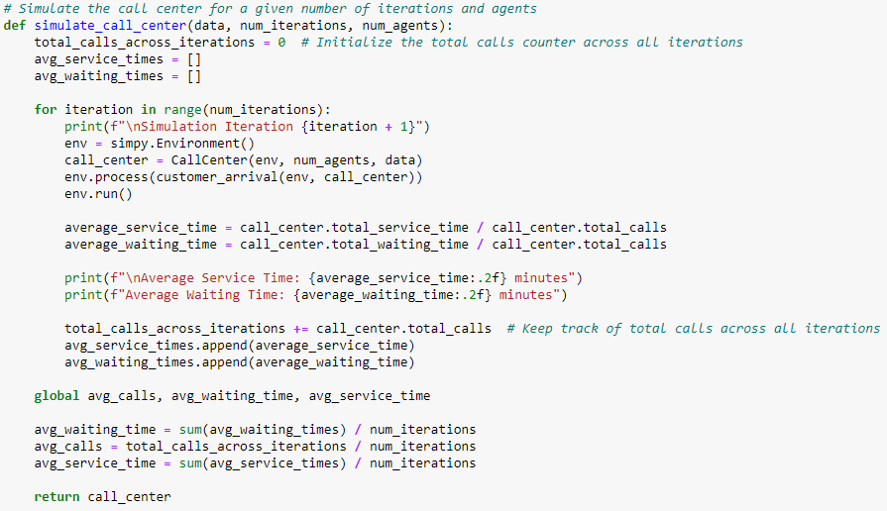

Slide 17
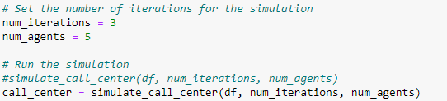

Slide 18
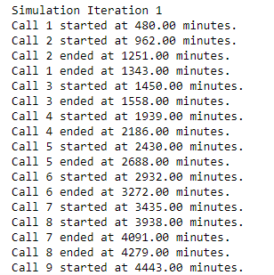
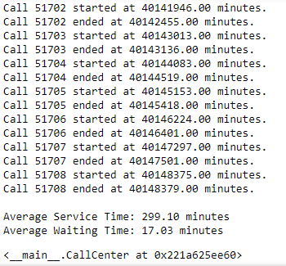

Slide 19
Justification for the Number of Iterations
The number of iterations in a simulation can vary based on the complexity of the process being modeled and the desired level of accuracy. For this demonstration, I will use a moderate number of iterations, to get a reasonable representation of the call center's performance. The number of iterations is dependent on the num_iterations variable and can be set as so desired.

Slide 20
MODEL VERIFICATION & VALIDATION

Slide 21
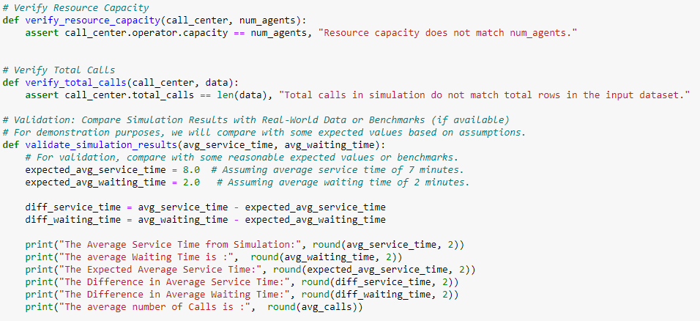

Slide 22
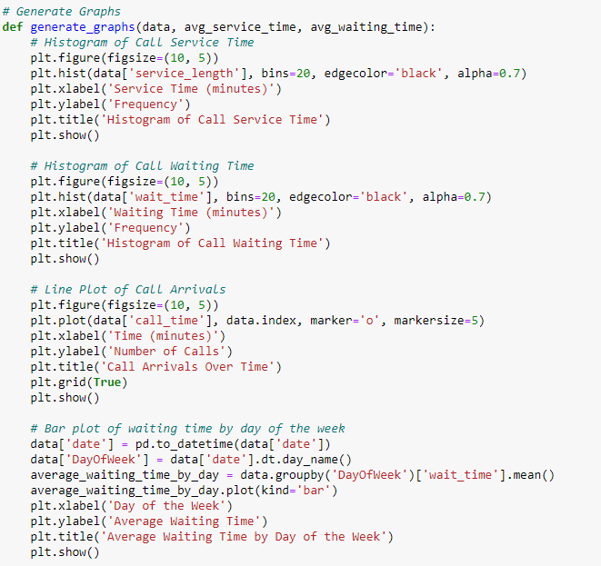

Slide 23
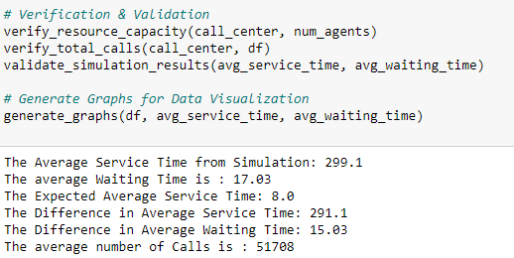
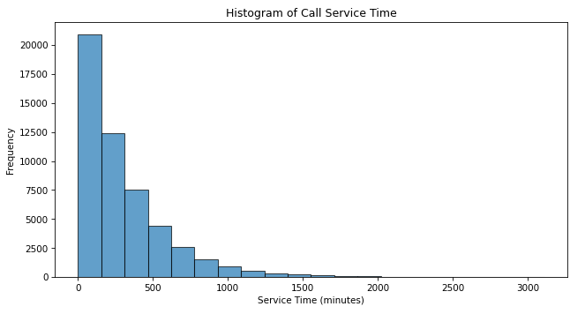

Slide 24
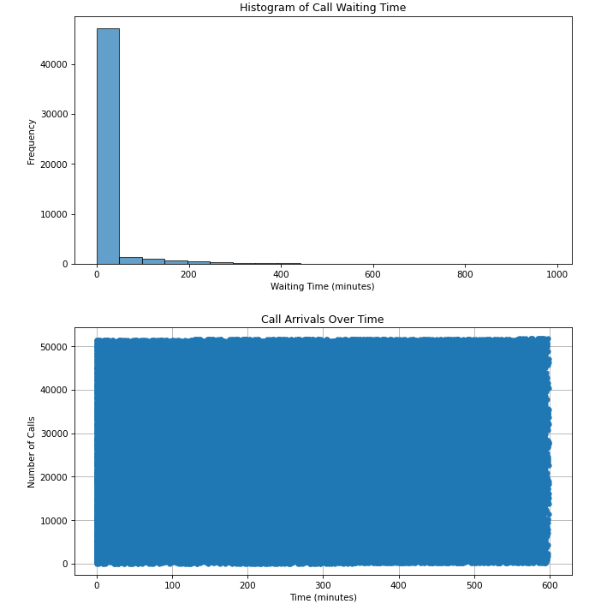

Slide 25
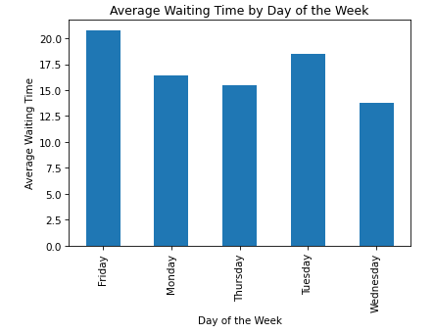

Slide 26
Conclusions and Findings
In the simulation above, the call center data was load from the CSV file. A simulate of call arrivals based on the historical data was done. The simulation runs until all calls are processed, and it outputs the total number of calls processed, total waiting time, and average waiting time.
The verification above shows that the average ait time is 17.03 mins and the average service time is 8 mins. Fridays and Tuesdays are the two days with the highest average wait time.

